Slide 1
Manaca
Jonathan Burgener

Slide 2
ASCII Mancala Game
Mancala is an ancient board game that is believed to originate from as far back as the 8th century (mancalagames.net).
The board has 6 pits on each side of the board, and a larger pit on each end. These larger pits are called a Mancala.
To play Mancala, the players take turns picking stones from a pit on their side and placing a single stone in each consecutive pit going counterclockwise around the board, skipping the mancala on their left.
The goal of the game is to get as many of the stones in your Mancala as you can.

Slide 3
The Board
To implement Mancala using Assembly, the board is created using characters from extended ASCII, or Alt Codes.
Since these characters are not in the normal ASCII set, Visual Studio does not recognize them without changing the encoding of the document.
Each character that makes up the board is represented by 3-digit numbers between 179 and 218.
Each round the board will be printed before and after the player makes their move, and the board will always keep the active player’s side on the bottom.

Slide 4
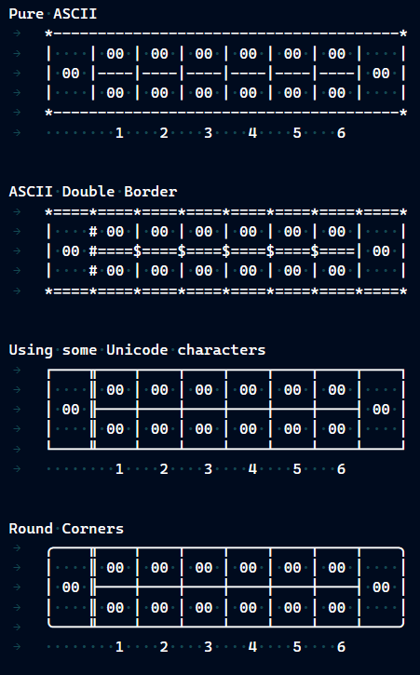
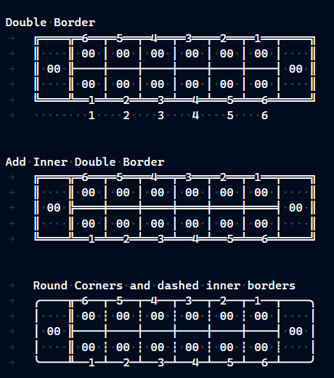

Slide 5
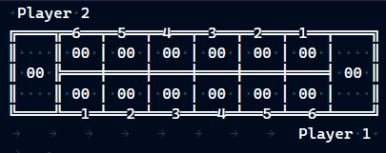
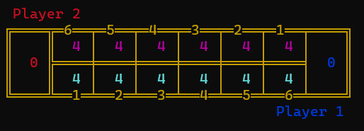

Slide 6
Irvine
Since the board is going to be flipping between each round, Irvine is used to add a bit of color to the board to help mitigate mix ups between who’s side is which.
Player 1’s pits are cyan with a blue Mancala.
Player 2’s pits are magenta with a red Mancala.
The board has a brown border.
As an extra bit, after the player makes a move, the placed stones will be light green, to show the player what pits they added stones to. The pit that was emptied is a dark green.
I would have liked to have added more color, but Irvine only has 16 predefined colors.

Slide 7
For What Reasons Did I Choose Mancala?
There are a couple of games I have been trying to make in as many programming languages as I can. These games include Mancala, Minesweeper, Connect 4, Tic-Tak-Toe, and Pong. So far, I have made most of these games in Java, C++, and Python. And I am also trying to learn C# to include it as well.
Mancala as a project idea came from Mr. Cook when I was in his Java class.
I’ve been making these same games across multiple programming languages to compare the similarities and different challenges each language has.

Slide 8
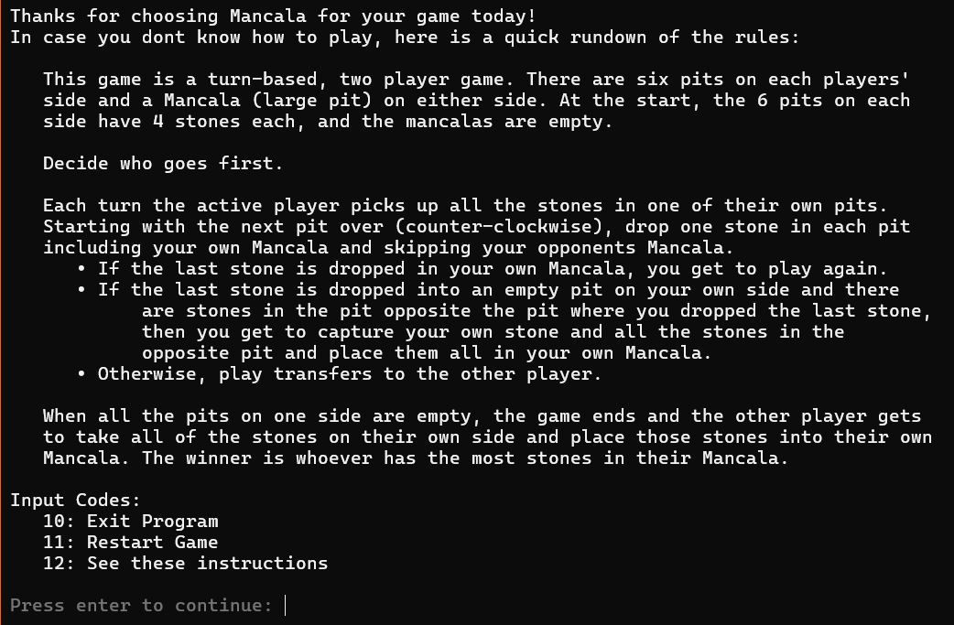

Slide 9
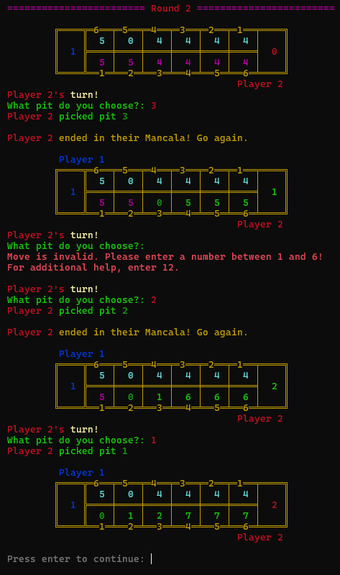
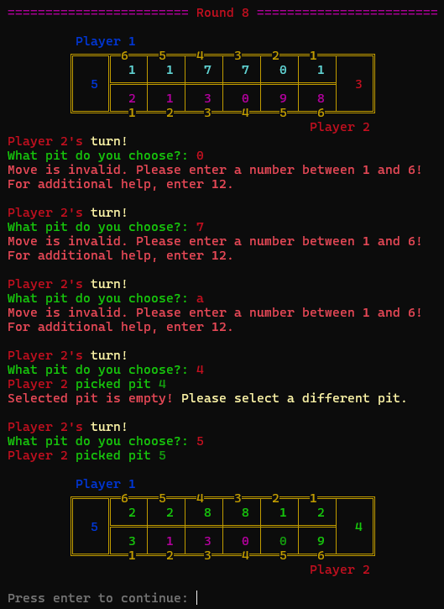
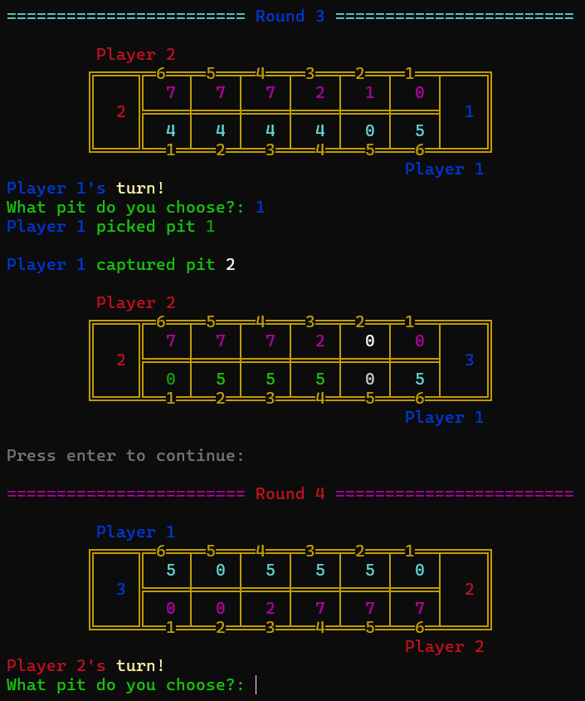

Slide 10
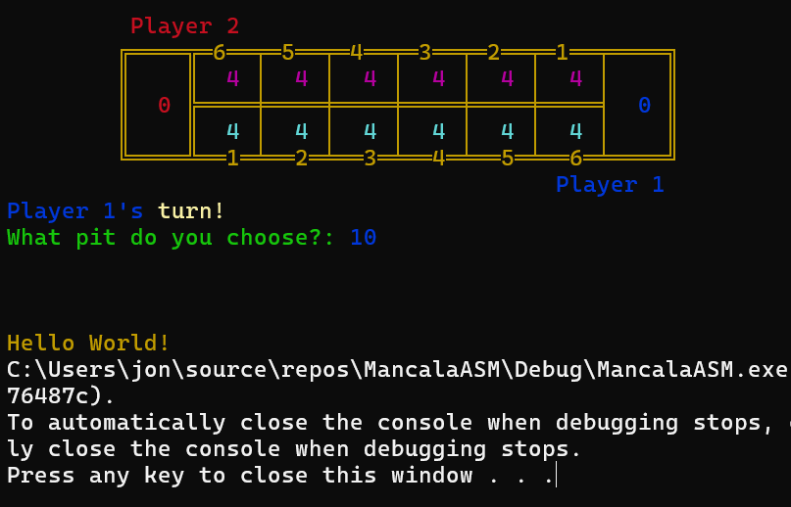
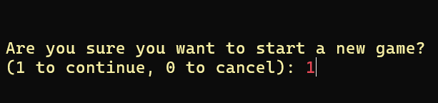
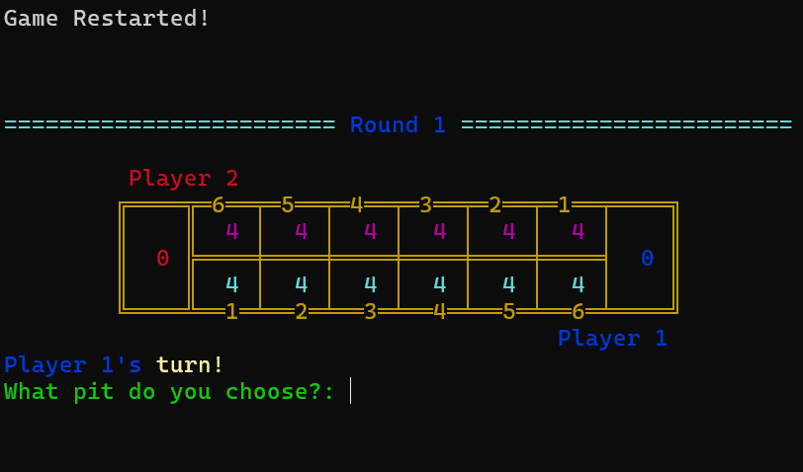
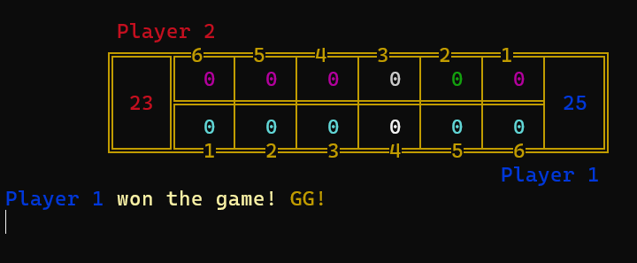

Slide 11
What Went Well?
Creating the board
Getting input figured out
Switching players
Adding game restart and instructions

Slide 12
What Would I Do Differently?
I would add more color.
Irvine was a pain to use with multiple files at first. Had to switch external references from “external procedureName: near” to “procedureName proto”
Add rounded corners to the board. Had them initially but after experiencing the issues with non-standard characters, I gave them up since they were not included in the extended ASCII.
Organization.

Slide 13
Conclusion
I am certainly more comfortable using Assembly now.
Learned the ways of arrays in assembly, along with the difficulties of arrays. (Similar to working with strings, just had to get the right algorithms)
Got to work with Irvine and learn how to use it.

Slide 14
Links! + Any Questions?
Project Link: https://github.com/JonathanBurg/Mancala-MASM
Source for origin date: https://www.mancalagames.net/2019/01/learn-ancient-history-of-mancala-origin.html#:~:text=700%20AD

